Slide 1
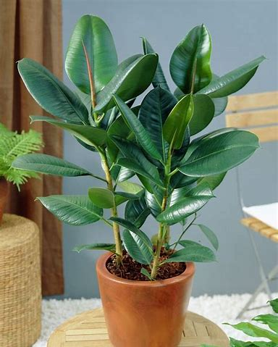
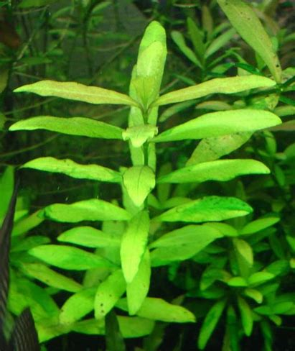
Daily Review
Like humans and animals, plants contain cells of many shapes, structures, and sizes.
Each type of cell is specialised to carry out a different function within the plant.
On your whiteboards, list three of the specialised types of cell in a plant.

Slide 2
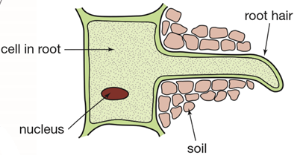
Daily Review
Identifying types of specialised plant cells
CFU 1
What type of cell is this?
CFU 2
What adaptations does it have?
This is a root hair cell.
It increases the surface area of the roots of a plant.
This allows more water and nutrients to be absorbed into the roots of the plant.
CFU 3
What is the function of the cell?

Slide 3
Plant Systems

Slide 4
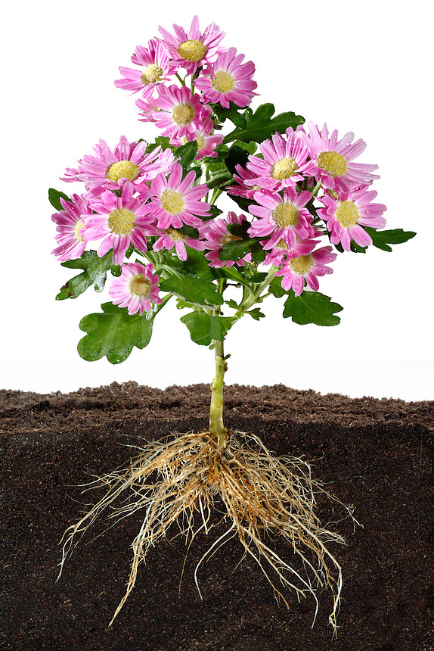
Learning Objectives
CFU
What are we going to learn?
Identify and describe the function of organs in plants.
Activate Prior Knowledge
Plants have many parts that allow it to perform the 7 characteristics of living things.
On your whiteboard, name as many different types of plants as you can.

Slide 5
Concept Development
CFU 1
What is the function of a plant’s stem?
CFU 2
Which organ absorbs water from the soil?
Organs in Plants
Plants are multicellular organisms.
They have specialised organs to transport water and nutrients around the plant.
Leaves exchange gases and produce food.
Flowers allow the plant to reproduce.
Stems transport the water and nutrients around the plant.
Roots absorb water from the soil.
CFU 3
What are the two functions of the leaves?
Vocabulary
multicellular (noun) Organisms that consist of more than one cell

Slide 6
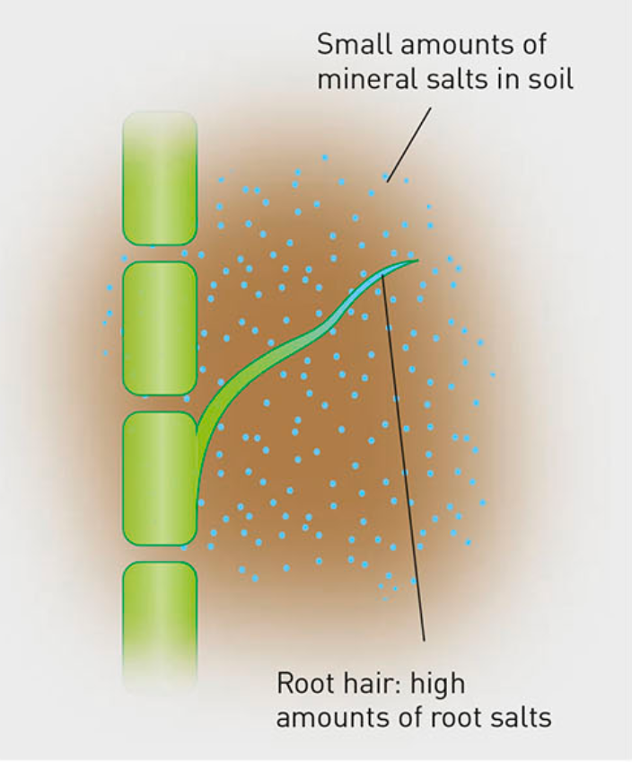
Concept Development
CFU 3
Think, Pair, Share: Which organs in the human body have structures similar to root hairs?
CFU 4
Explain how the roots absorb substances.
CFU 1
What are the two functions of a plant’s roots?
CFU 2
Why do root cells have small hairs?
Roots
Anchor the plant in the soil and absorb water and nutrients from the soil.
Root cells have small root hairs to increase the amount of surface area used for absorption.
First, roots absorb salts from the soil and store them in the cells.
The inside of the roots become more ‘salty’.
Water is attracted to the salts in the roots and moves into the roots through osmosis.
Vocabulary
Osmosis Movement of water from an area of low salt concentration to high salt concentration

Slide 7
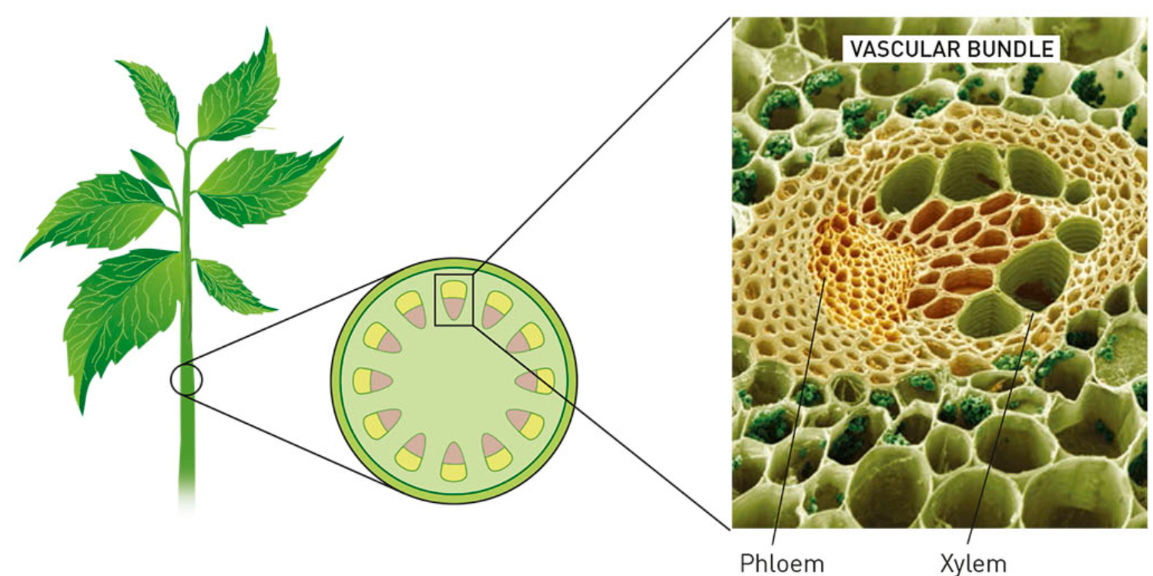
Concept Development
CFU 1
What is the function of a plant’s stem?
CFU 2
What are the two types of tubes in a vascular bundle?
CFU 3
What does xylem transport?
CFU 4
How does water move up the xylem?
Stem
The stem transports substances between the roots and the leaves.
Vascular bundles are groups of two types of tubes in the stem, called xylem (zi-lem) and phloem (flo-em).
Xylem transports water from the roots to the leaves
As water evaporates from the leaves (transpiration) other water molecules move up to replace it.
This can pull water to the top of a 10m tree.

Slide 8
Concept Development
CFU 1
What is the function of a plant’s stem?
Stem
The stem transports substances between the roots and the leaves
Vascular bundles are groups of two types of tubes in the stem, called xylem (zi-lem) and phloem (flo-em)
Phloem is a network of cells in the stem.
It transports glucose (food) made in the leaves to other parts of the plant.
The sugars provide the plant with the energy it needs to stay alive.
CFU 2
What are the two types of tubes in a vascular bundle?
CFU 3
What does phloem transport?

Slide 9
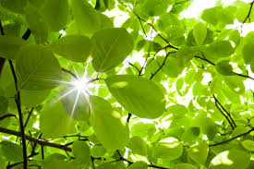
Concept Development
CFU 1
What is the function of a plant’s leaves?
CFU 2
Which gas is taken in through the leaves?
Leaves
The leaves are involved in exchanging gases and producing food for the plant.
Carbon dioxide enters the cells in the leaves.
The leaves use energy from the Sun to convert water and carbon dioxide into glucose and oxygen (this is photosynthesis).
The waste oxygen is released into the air.
CO₂ + H₂O → C₆H₁₂O₆ + O₂
Carbon dioxide + water → glucose + oxygen
CFU 3
Explain the process of photosynthesis.
CFU 4
Photosynthesis produces which two substances?

Slide 10
Skill Development/Guided Practice
Collect and complete a graphic organiser using the information on the following slides.

Slide 11
Skill Development/Guided Practice
Roots
Anchor the plant and absorb water and nutrients from the soil.
Absorb salts from the soil and store them in the cells.
Water is attracted to the salts in the roots and moves into the roots.

Slide 12
Skill Development/Guided Practice
Stem
The stem transports substances between the roots and the leaves.
Xylem transports water from the roots to the leaves.
As water evaporates from the leaves other water molecules move up to replace it pulling it up the plant.
Phloem is a network of cells in the stem.
It transports glucose made in the leaves to other parts of the plant to give it energy.

Slide 13
Skill Development/Guided Practice
Leaves
The leaves are involved in exchanging gases and producing food for the plant.
Carbon dioxide enters the cells in the leaves.
The leaves use energy from the Sun to convert water and carbon dioxide into glucose and oxygen.
The waste oxygen is released into the air.

Slide 14
Skill Development/Guided Practice
Photosynthesis
CO₂ + H₂O → C₆H₁₂O₆ + O₂
Carbon dioxide + water → glucose + oxygen

Slide 15
Relevance
Knowing how organs work together in a system and how the systems interact with each other will help you understand how the body works.
Understanding the structure and function of plant systems will help you understand how plants obtain their food and provide us with oxygen.

Slide 16
Skill Closure
Plant Organ Function
1 Leaves A Transports substances up and down the plant
2 Roots B Absorbs water and nutrients from the soil
3 Flowers C Gas exchanges and food production happens
4 Stem D Used for reproduction
Skill Closure
What are the two products of photosynthesis?
Skill Closure
How is xylem different to phloem?

Slide 17
Independent Practice
Complete questions 1, 2, 3, 5 and 6 on page 135 of the text book.

